Slide 1
SECURE DATA HIDING In IMAGE USING STEGANOGRAPHY
CAPSTONE PROJECT
Presented By: Alexy Anna P Sebastian
College Name & Department : BSc Mathematics University of kerala

Slide 2
OUTLINE
Problem Statement
Technology used
Wow factor
End users
Result
Conclusion
Git-hub Link
Future scope

Slide 3
Problem Statement
In the digital age, secure communication is crucial to protect sensitive information
from unauthorized access. Steganography enables data hiding within images,
making it imperceptible to the human eye while ensuring confidentiality.
This project aims to develop a robust method for embedding and extracting hidden data
in images while maintaining image quality and security.
The challenge lies in achieving high imperceptibility, security, and resistance to attacks.

Slide 4
Technology used
CV 2
Python

Slide 5
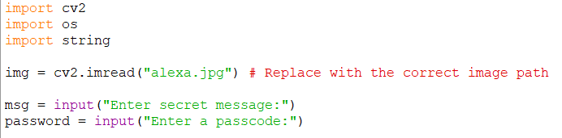
Wow factors
This project stands out by incorporating encryption before embedding the data,
ensuring an extra layer of security. It also utilizes adaptive steganography,
selecting image regions dynamically to minimize detection risks.
Additionally, the system is designed for real-time data extraction, allowing efficient retrieval
without compromising image quality.

Slide 6
End users
The end users of this project include cybersecurity professionals,
who use steganography for secure communication, and journalists or activists,
who need to protect sensitive information. Additionally,
government agencies and intelligence organizations may utilize it for covert data transmission,
while corporate sectors can apply it for confidential document security.

Slide 7
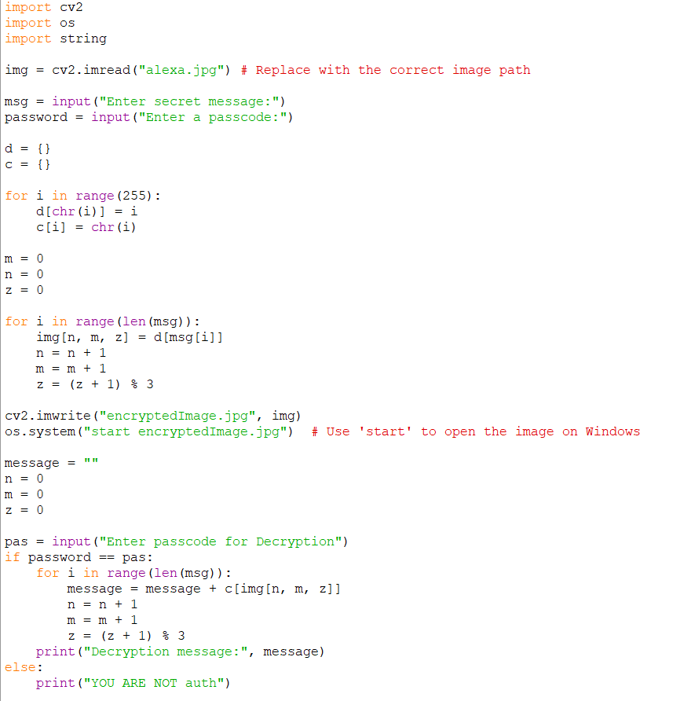


Results input image output image

Slide 8
Conclusion
Steganography is a powerful technique for secure data hiding within images,
ensuring confidentiality and minimizing the risk of detection.
This project successfully implements an image-based steganographic method,
allowing users to embed and retrieve secret messages securely.
By integrating encryption and password protection, the system enhances security,
making it a reliable solution for covert communication in cybersecurity applications.

Slide 9
GitHub Link
https://github.com/Alexaann04/cybersecproj-files.git

Slide 10
Future scope(optional)
Enhanced Security – Future implementations can integrate advanced encryption
algorithms like AES or RSA to improve data protection.
AI-Based Detection Prevention – Machine learning techniques can be employed to
make steganographic methods more resistant to steganalysis.
Cross-Media Steganography – Expanding beyond images, this technique can be
extended to videos, audio, and other multimedia formats.
Cloud Integration – Secure cloud-based steganography can facilitate
encrypted communication over networks.
Real-Time Applications – Future developments can focus on real-time secure messaging
using steganographic methods for high-stakes cybersecurity applications.

Slide 11
THANK YOU

